Slide 1

Wakefield Application Process

Slide 2
To apply to Minsthorpe Post 16
Go to https://www.wakefieldprospectus.co.uk/
Then use the following slides to guide you through the process

Slide 3
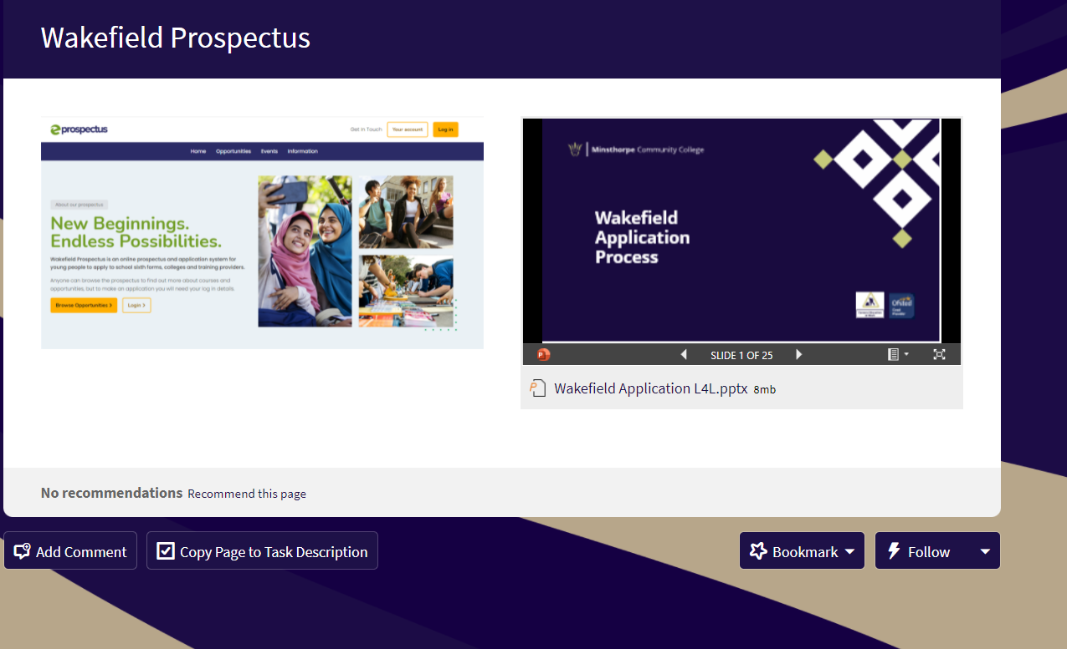
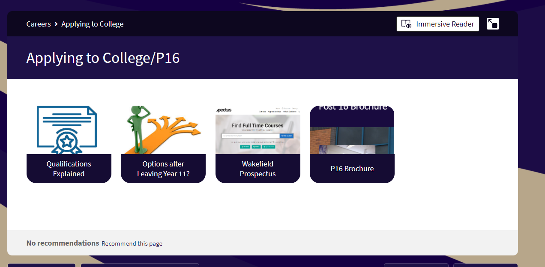
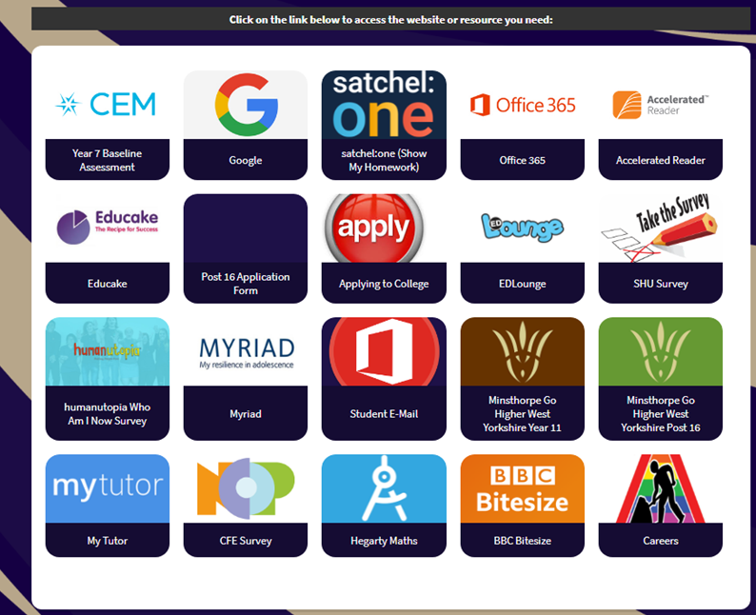
How to apply to college
Click apply on your screen
Click Wakefield Prospectus
Click right for the Wakefield prospectus or clicking on the PP will give you a step by step guide to applying

Slide 4
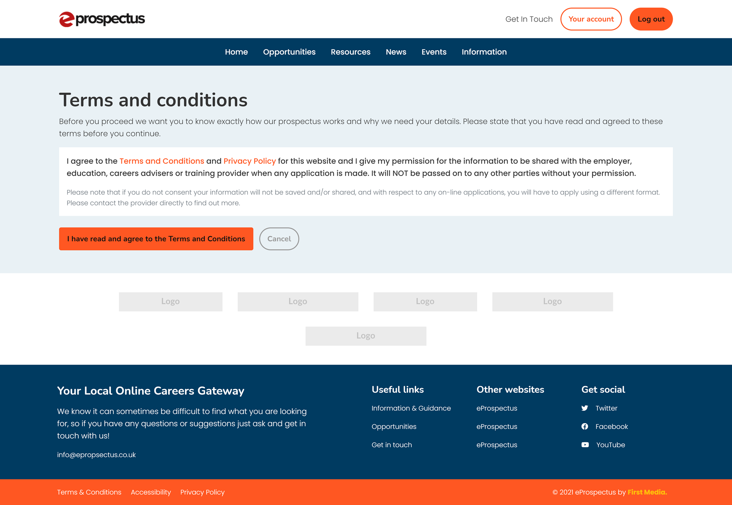
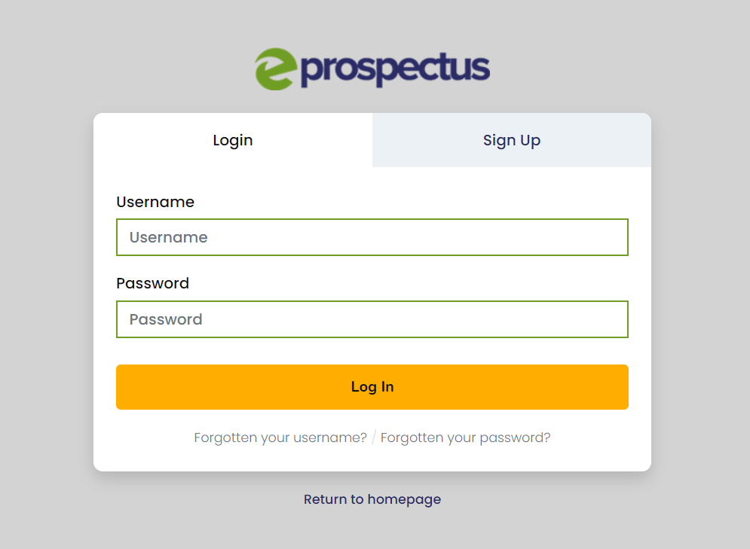
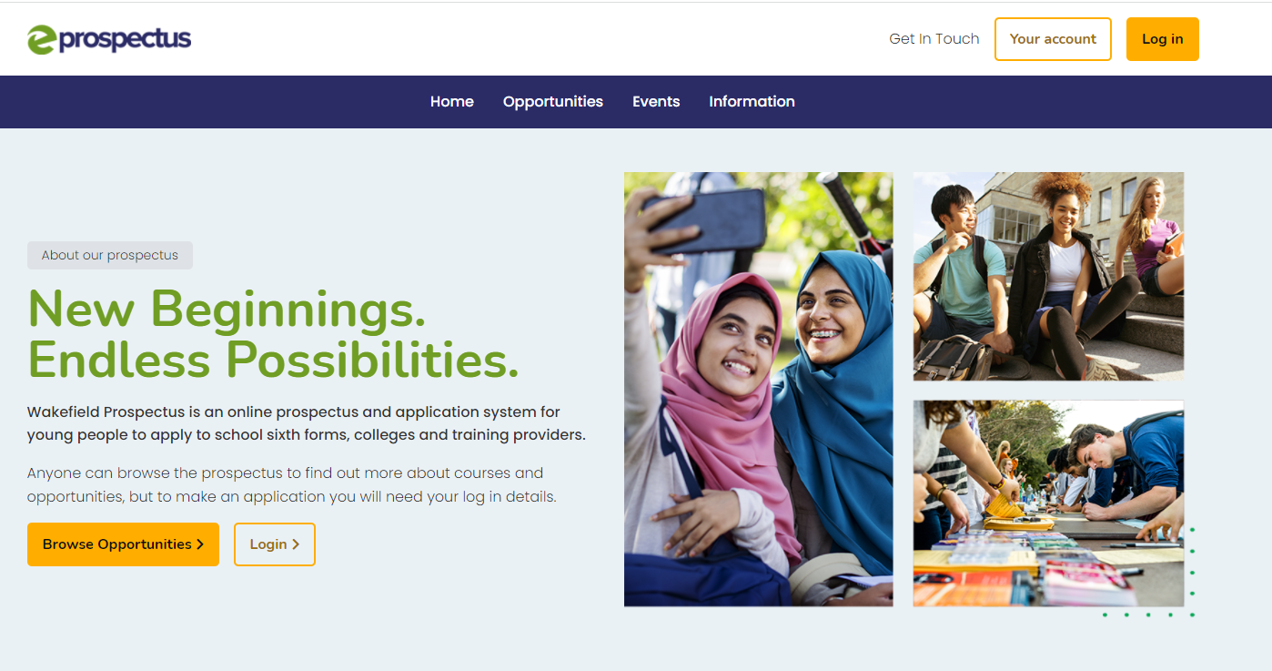

You will receive a username & password.
Click log on and then add username and password.
You will need to agree to the terms and conditions

Slide 5
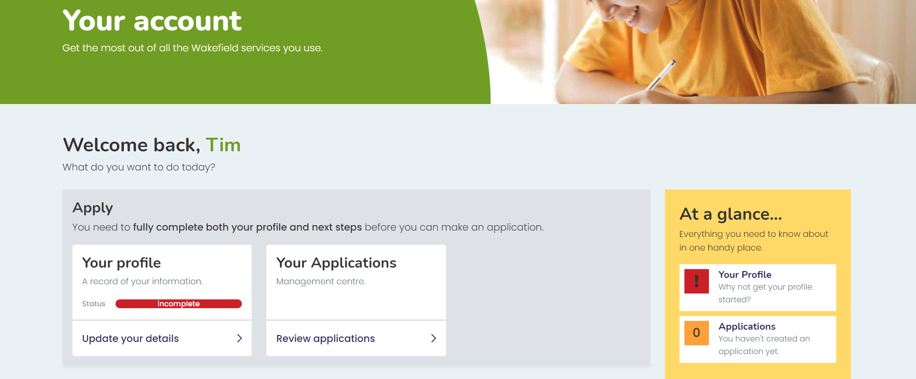
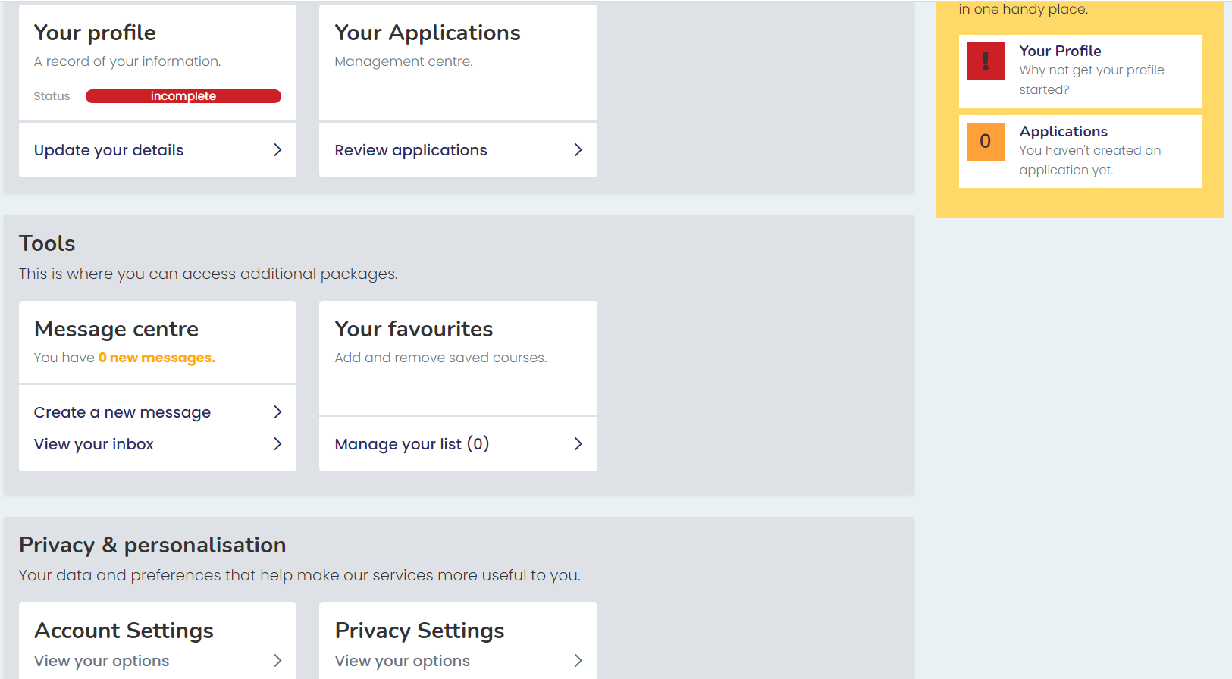
This is your home screen.
Click Your profile – update your details

Slide 6
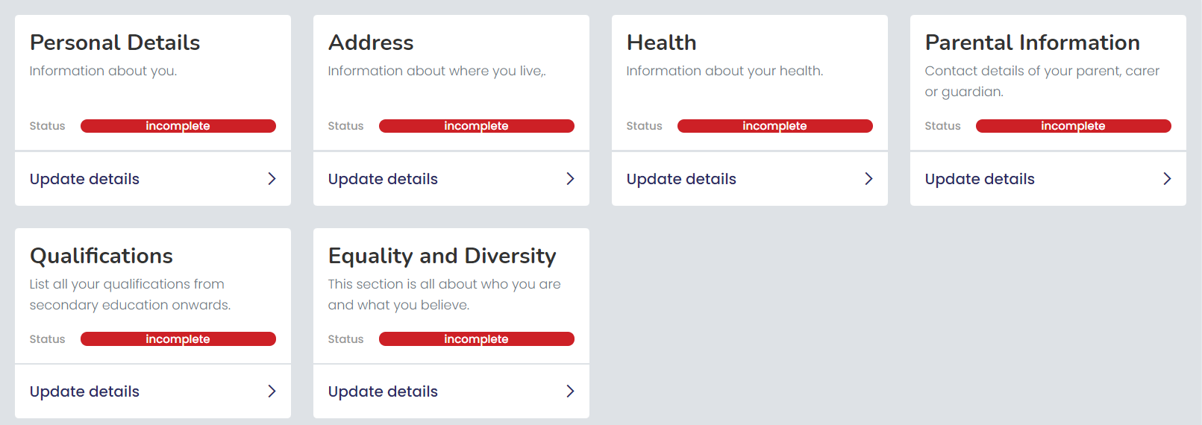
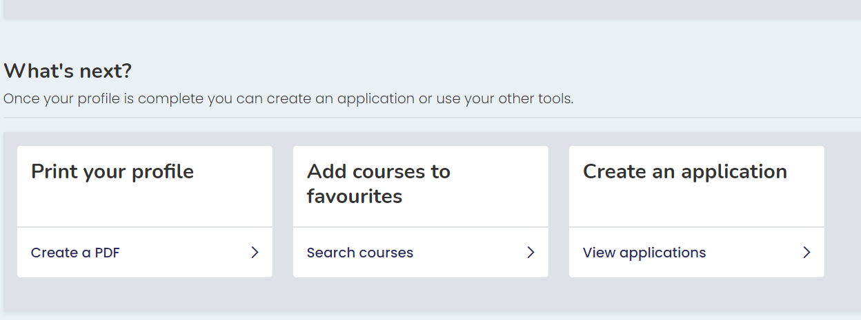
You then need to complete all these sections – just click on the Update details

Slide 7
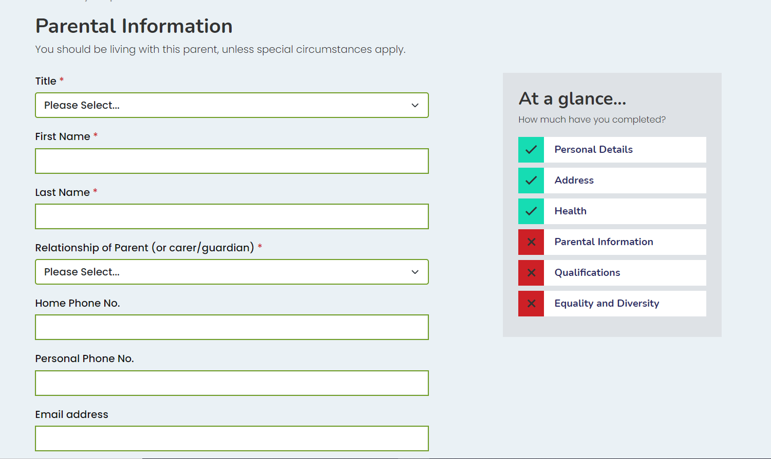
As you go through the sections you will notice they turn green when completed – all sections must be green for your application to send.

Slide 8
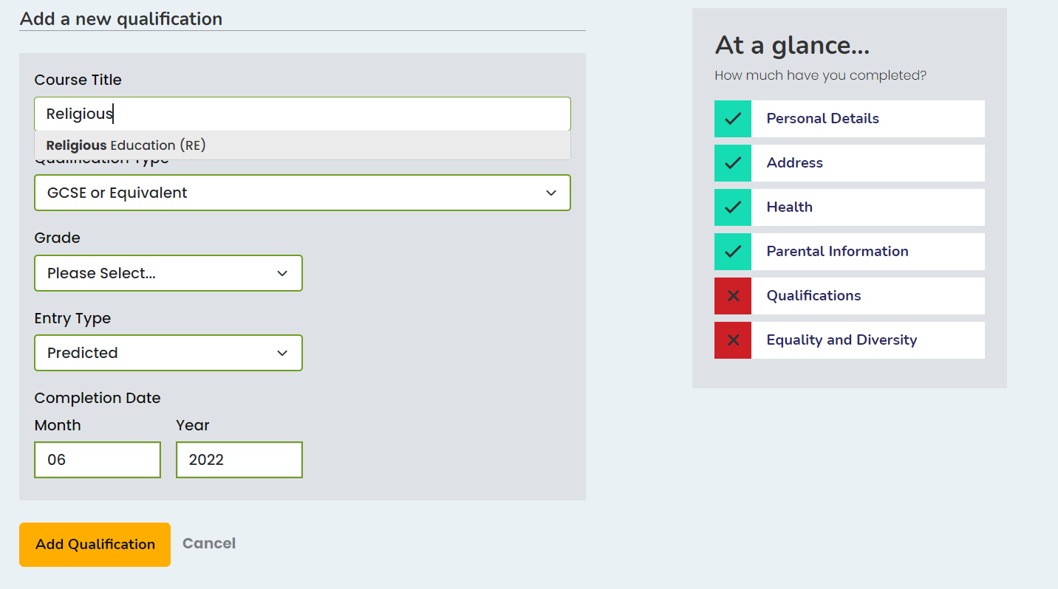
To add a subject start typing the subject name
Choose qualification type from the drop down box
Enter your grade and entry type – Predicted or actual – English Literature will be actual

Slide 9
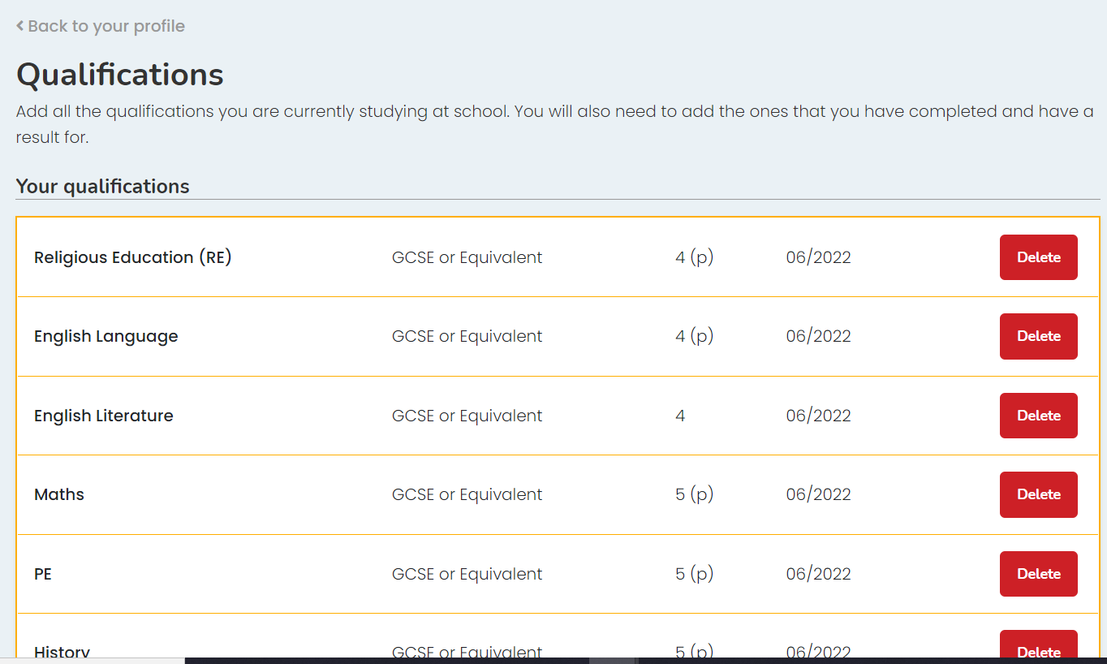
Once you have added all your qualifications – click back to profile

Slide 10
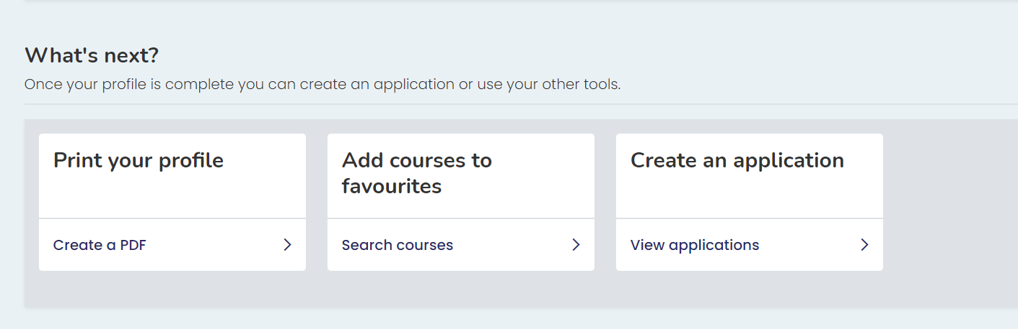
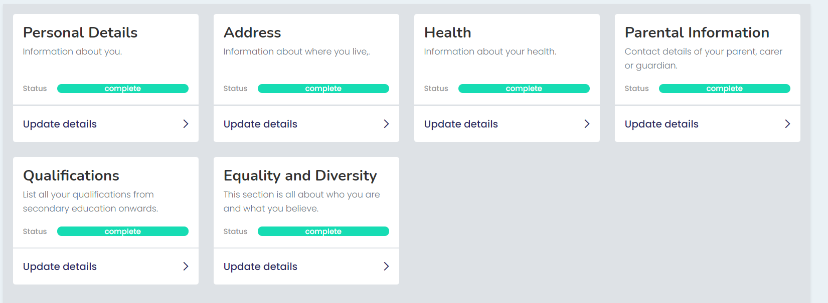
Now we need to start choosing our options – click search courses
The information for your application is now complete – as you can see all the sections are highlighted green.

Slide 11
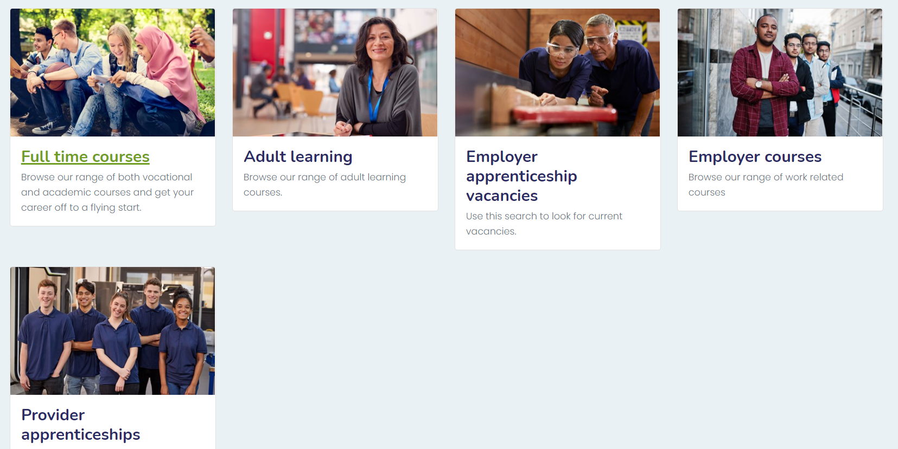
For this presentation we are going to use full time courses, but if you are interested in apprenticeships then please research them, but be aware that colleges only offer the training – NOT THE PAYMENT PART, YOU WILL NEED TO FIND AN EMPLOYER TO PAY YOU. So the advice would be to apply for a full time course just in case.

Slide 12
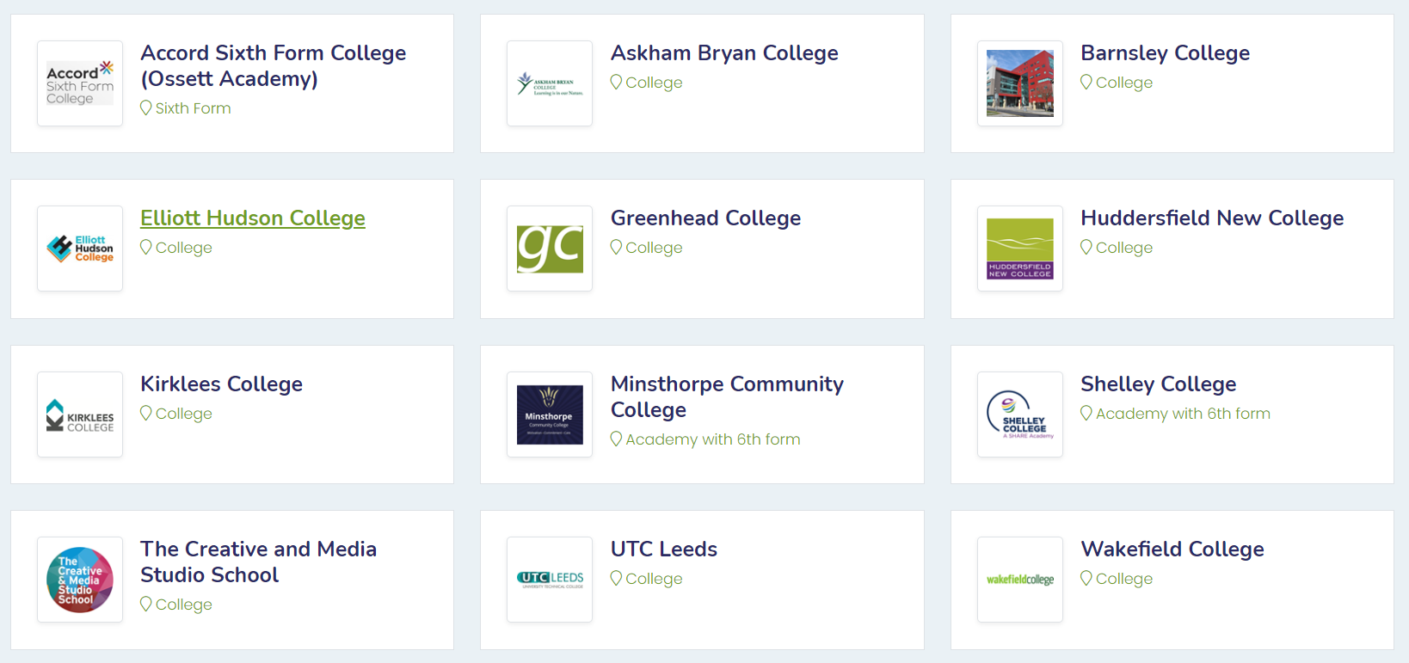
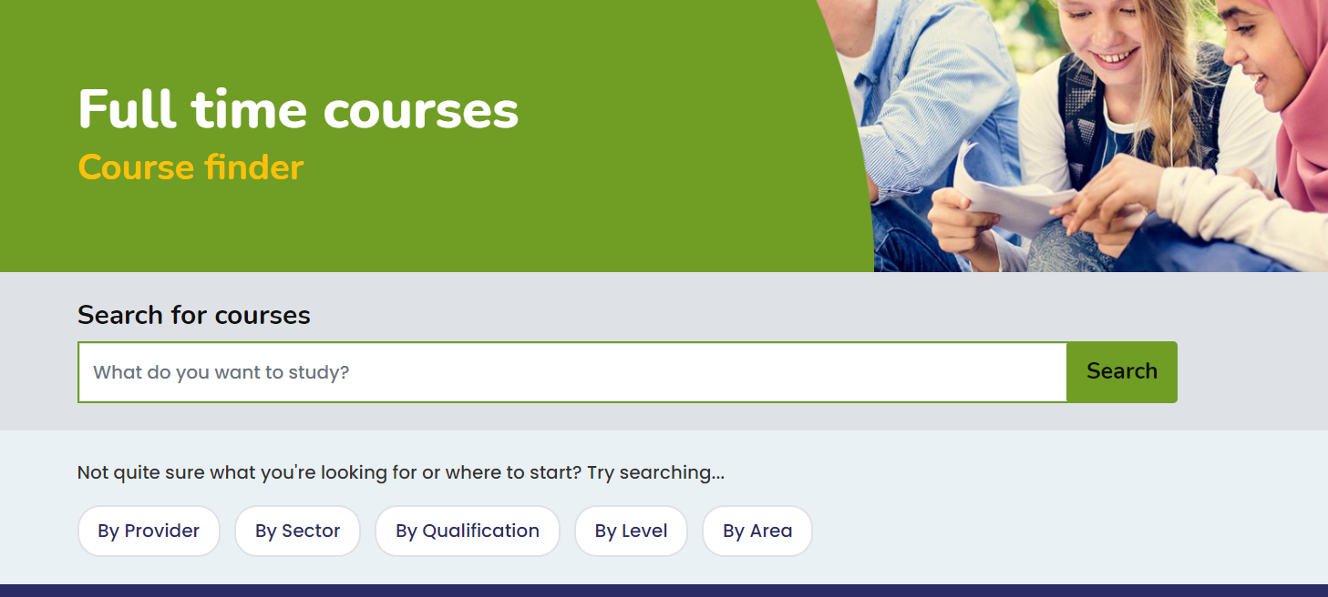
If you are applying to Minsthorpe Click here
If you know where you want to go then it is best to search by provider

Slide 13
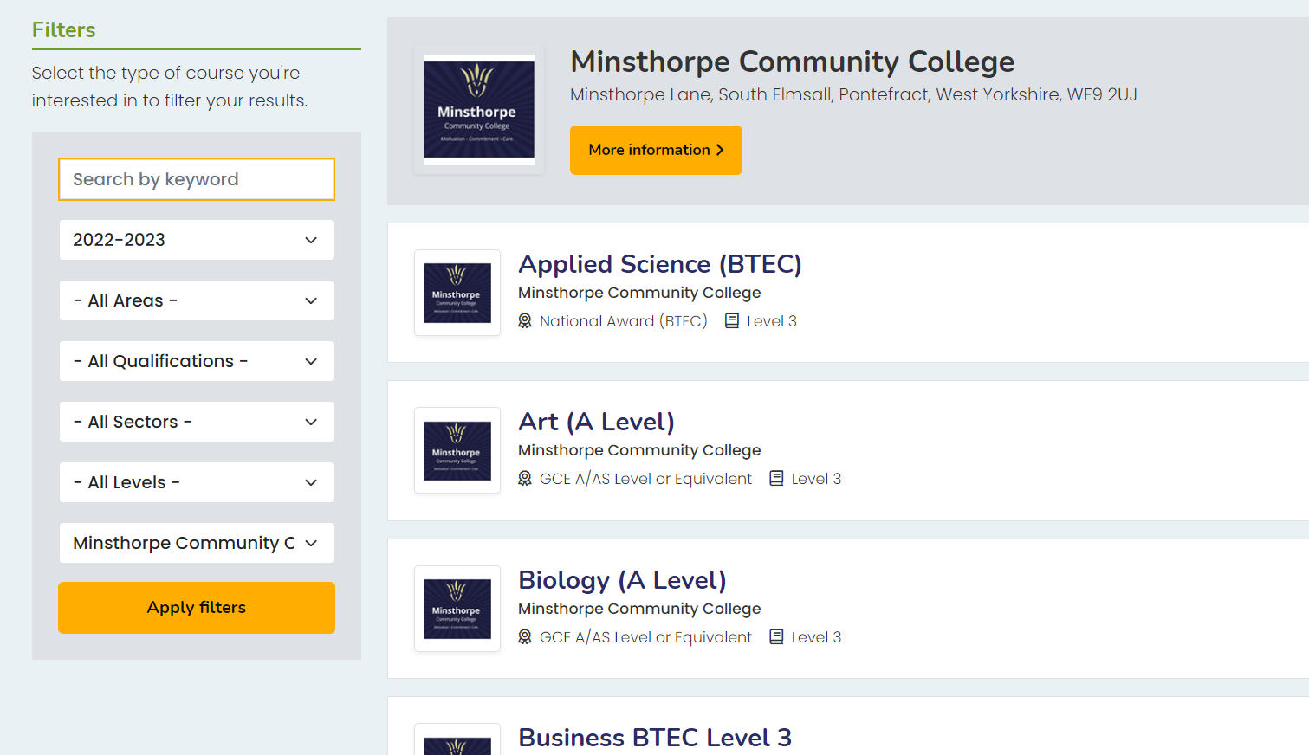
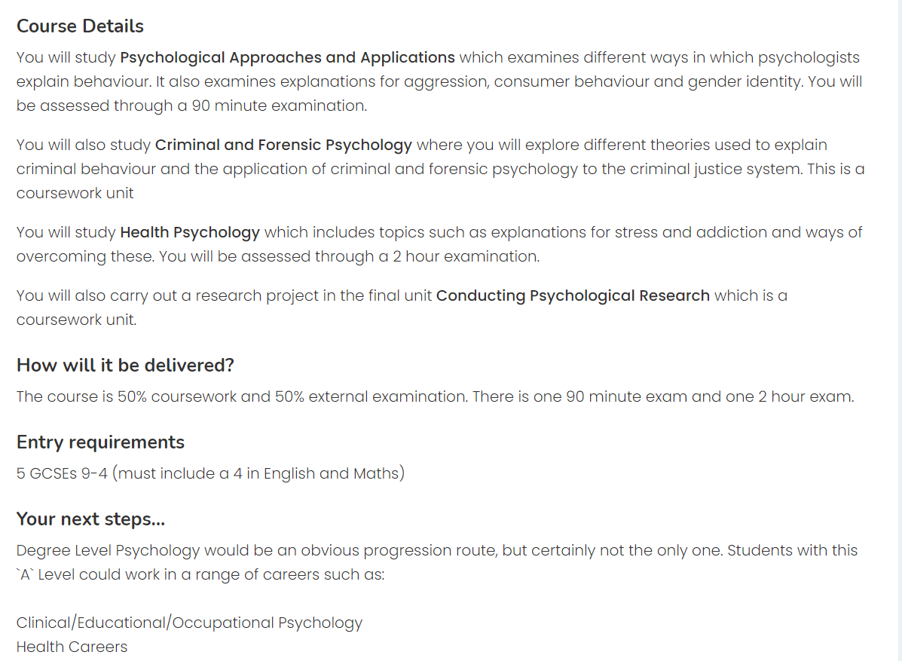
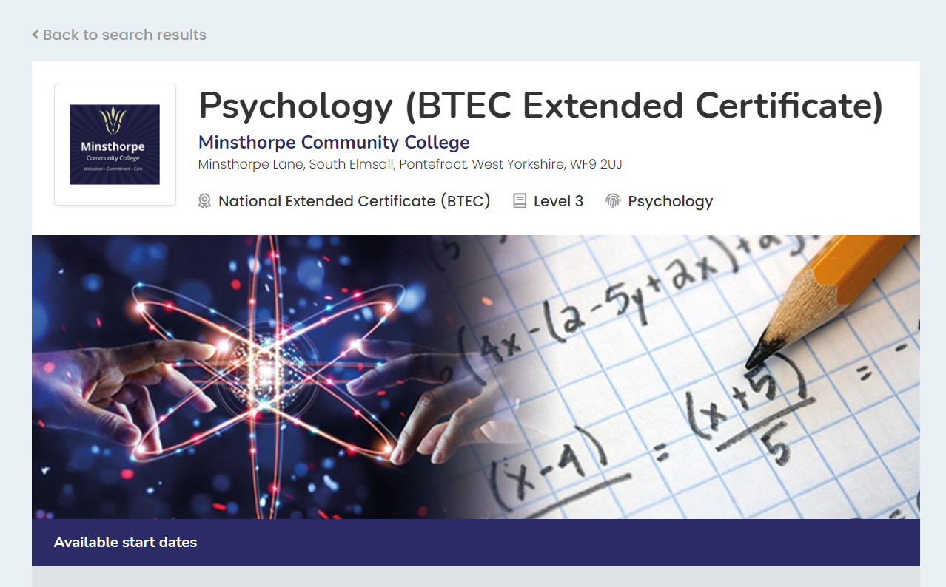
You can now start choosing your subjects
By clicking on a subject you can research the skills, course details, next steps and the entry requirements for the subject.
Next steps – It is important that if you have a career in mind that involves studying a degree at University or a Degree Apprenticeship that you RESEARCH the entry requirements of the degree you will need to study.
For example if you want to study Medicine you will need to study A Level Chemistry, plus one from Biology, Maths or Physics

Slide 14
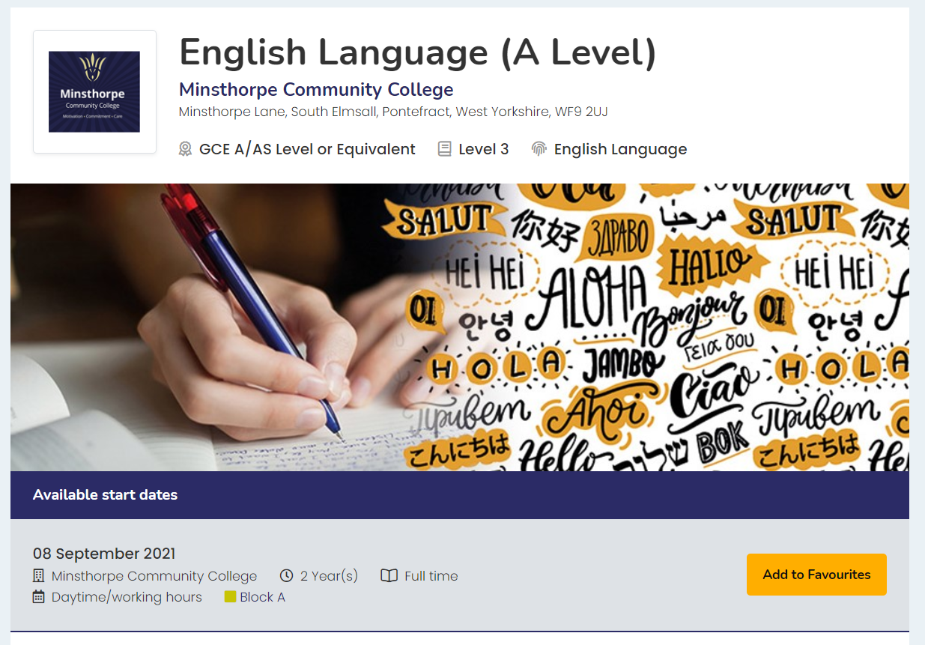
Choosing my subjects – Just add to favourites. Remember you need to add 3 subjects – If you choose Double Health & Social Care or Double sport this will take up two of your options.

Slide 15
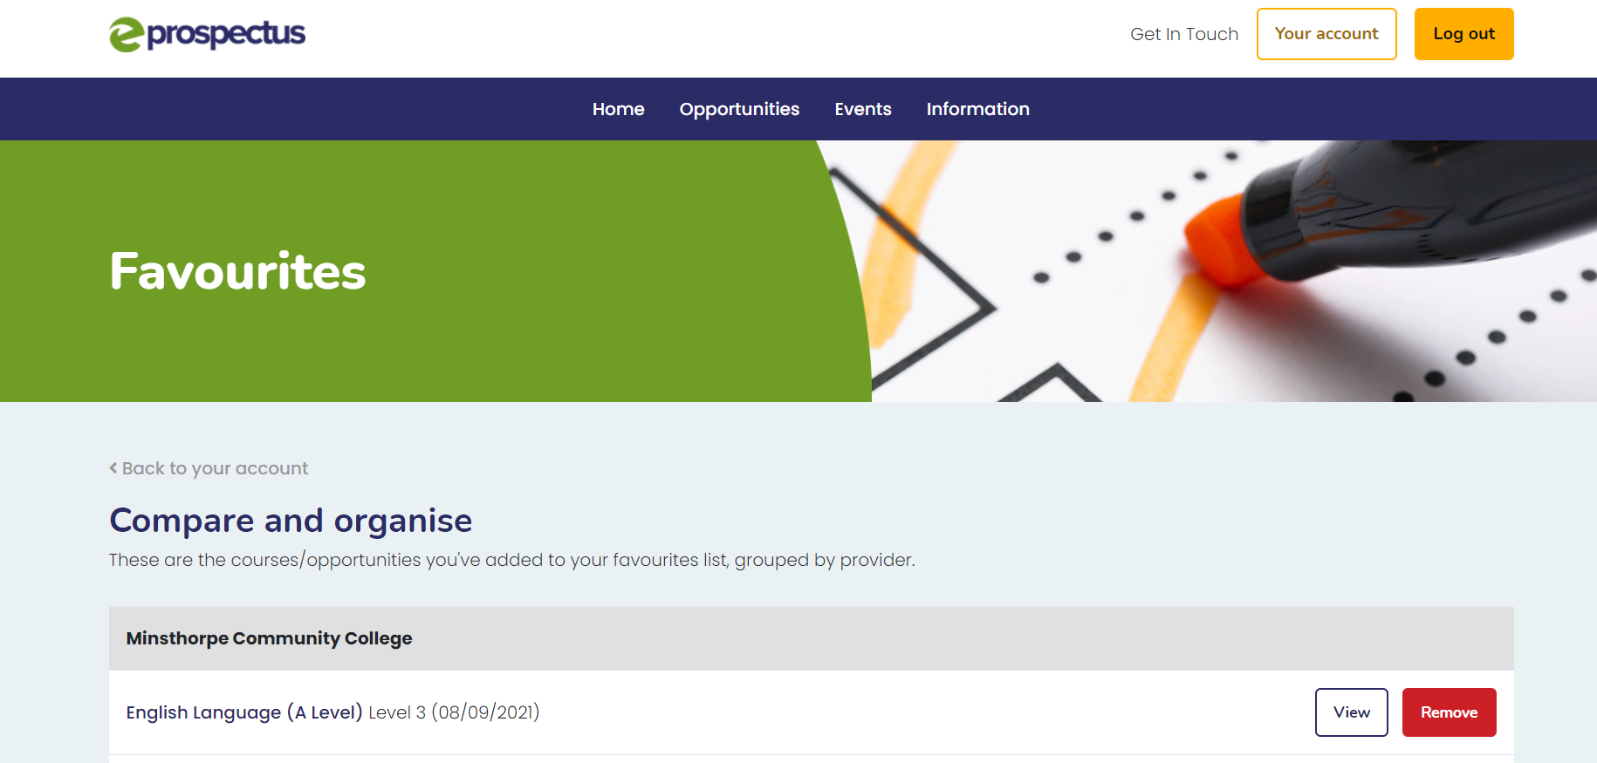
Click on your account

Slide 16
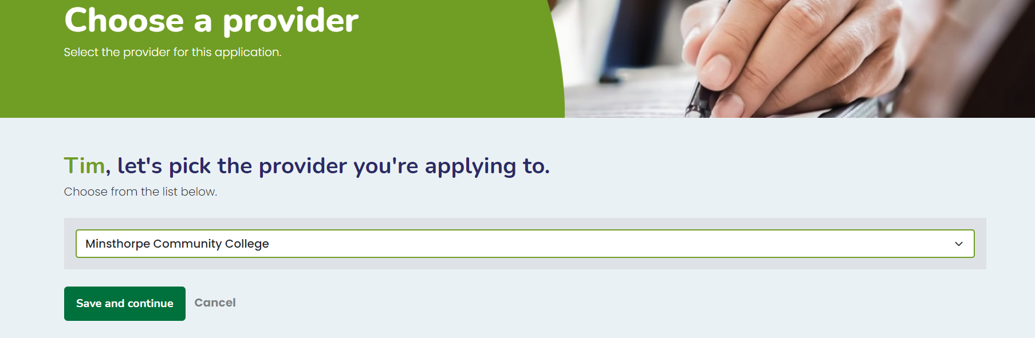
Please select the provider you are applying too, this should match the courses you have in your favourites.
Click save and continue

Slide 17
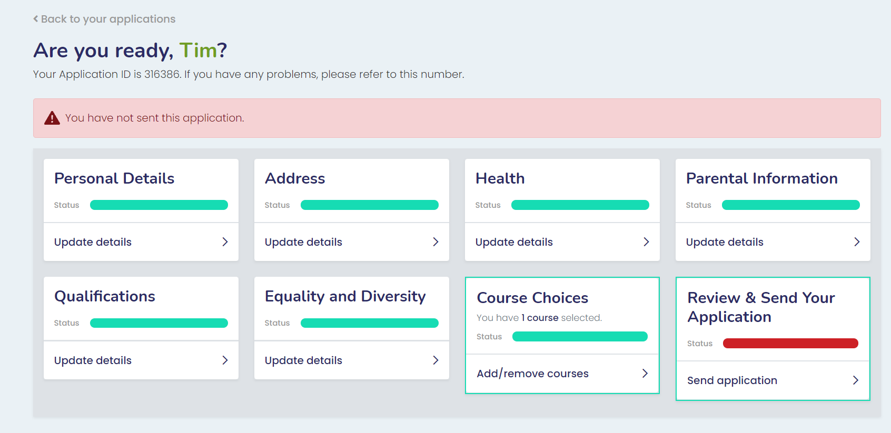
Click course choices and add / remove courses

Slide 18
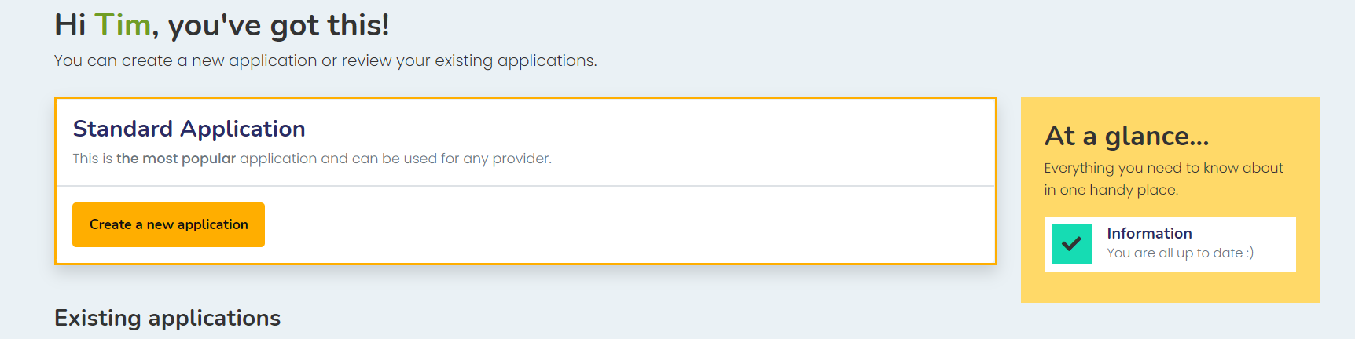
Click create a new application

Slide 19
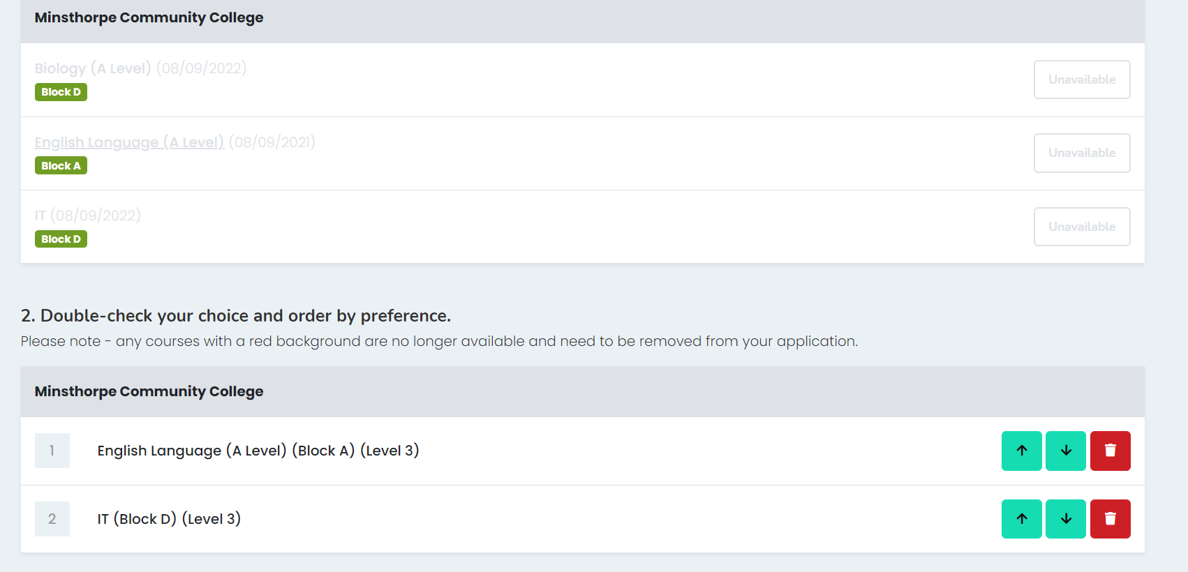
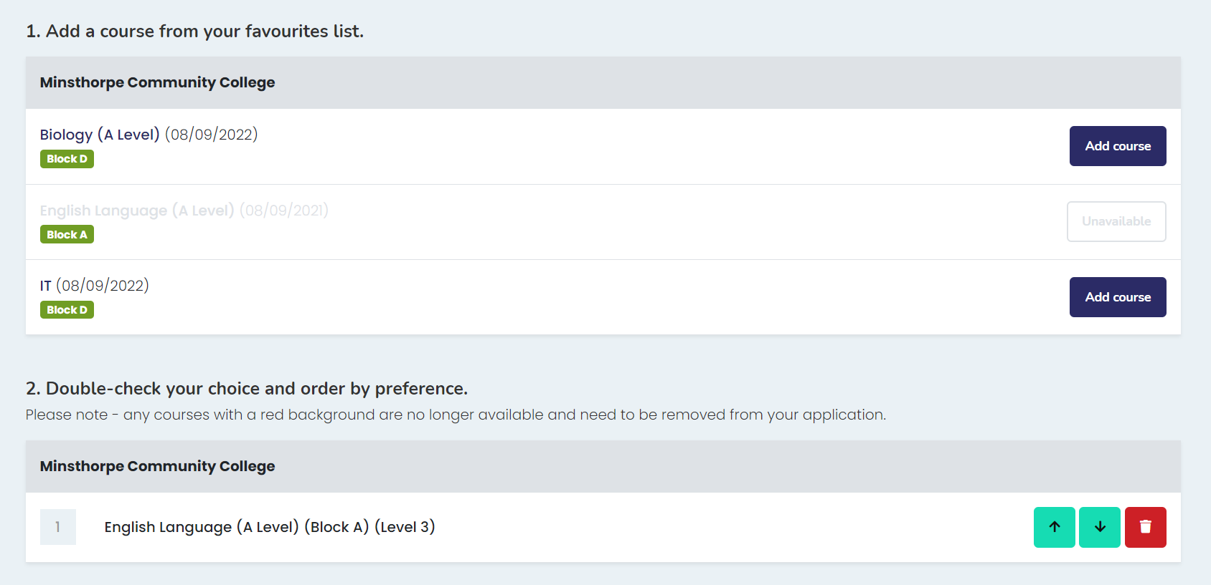
Then you will see the other automatically disappears – this is because they are in the same Block – So please make sure you are choosing 1 subject from each Block – max 3 subjects (so could be A,B,C or B,C, D ETC.)
Here you are choosing your subjects from your favourites – notice I have 2 from Block D – If I choose 1 of them

Slide 20
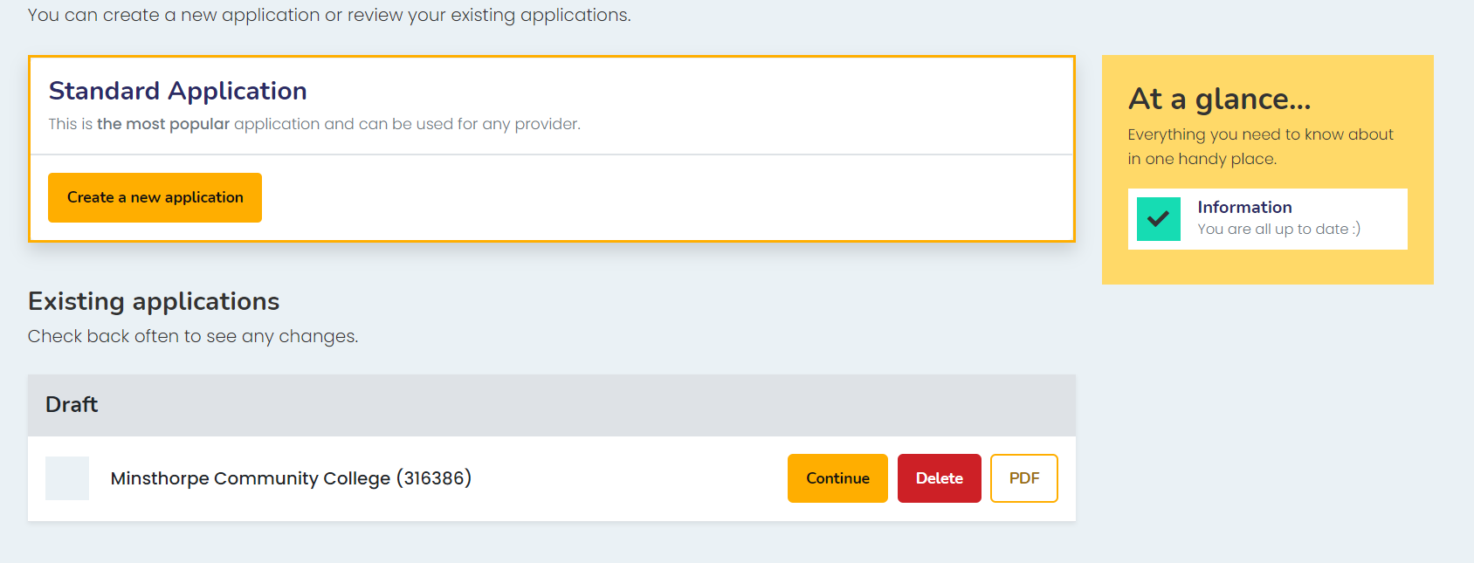
Your application will be saved as a draft – click continue, obviously only if you need to add other subjects or you need to come back to your application

Slide 21
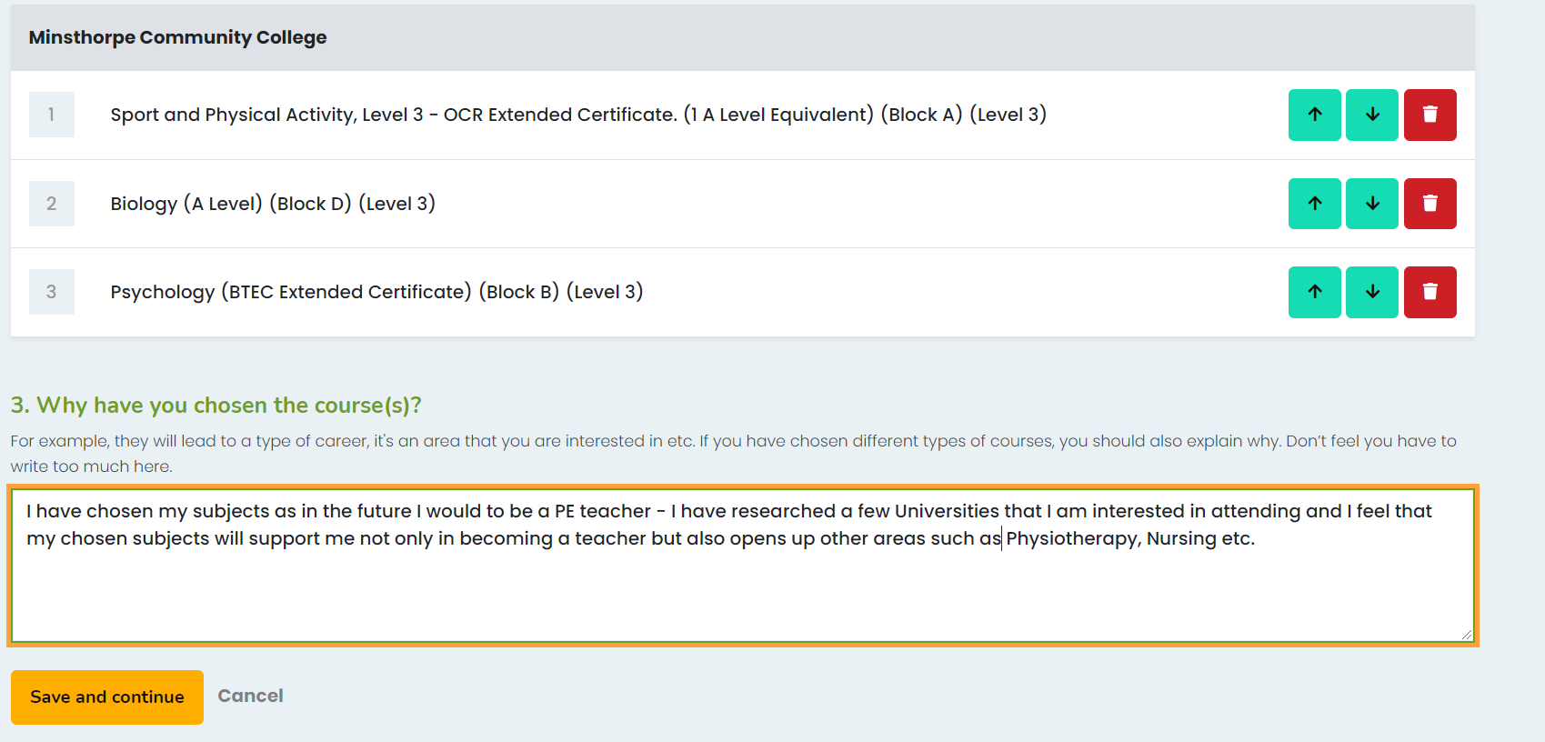
This is where your research will be useful – why have you chosen your subjects?

Slide 22
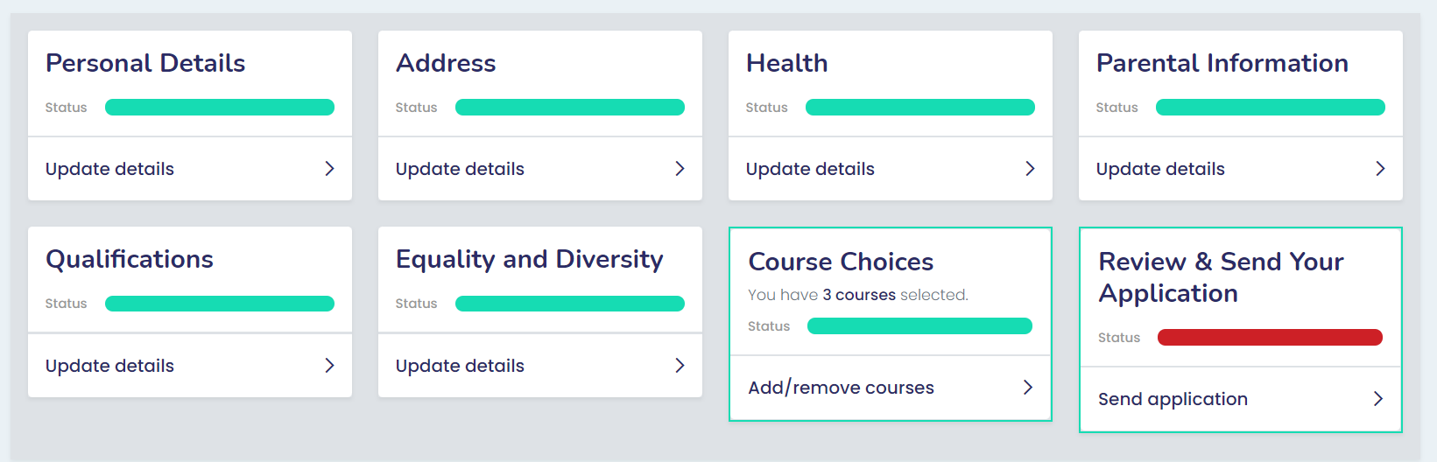
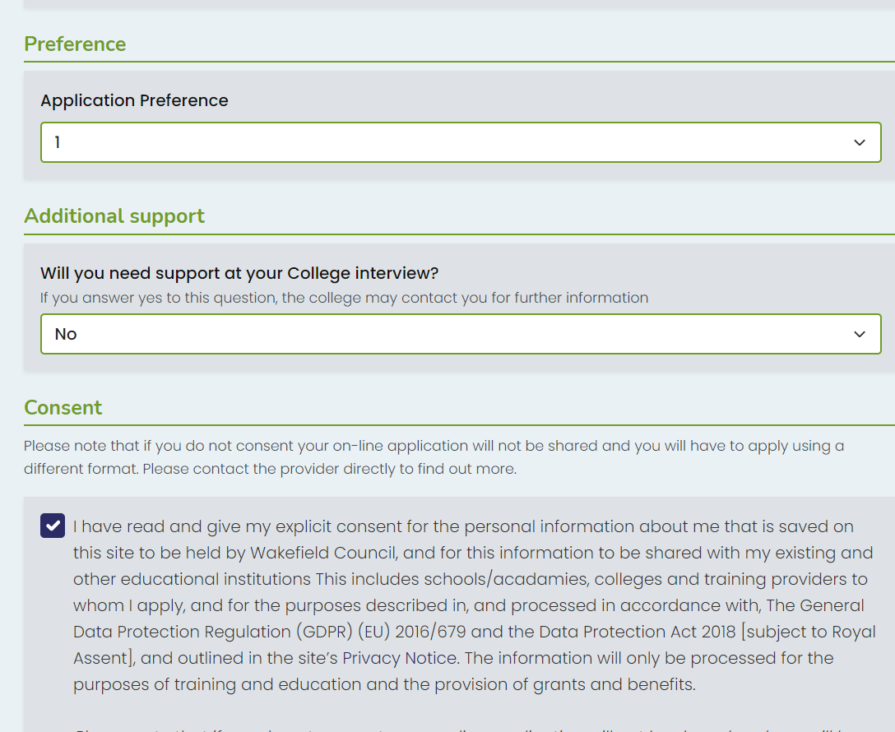
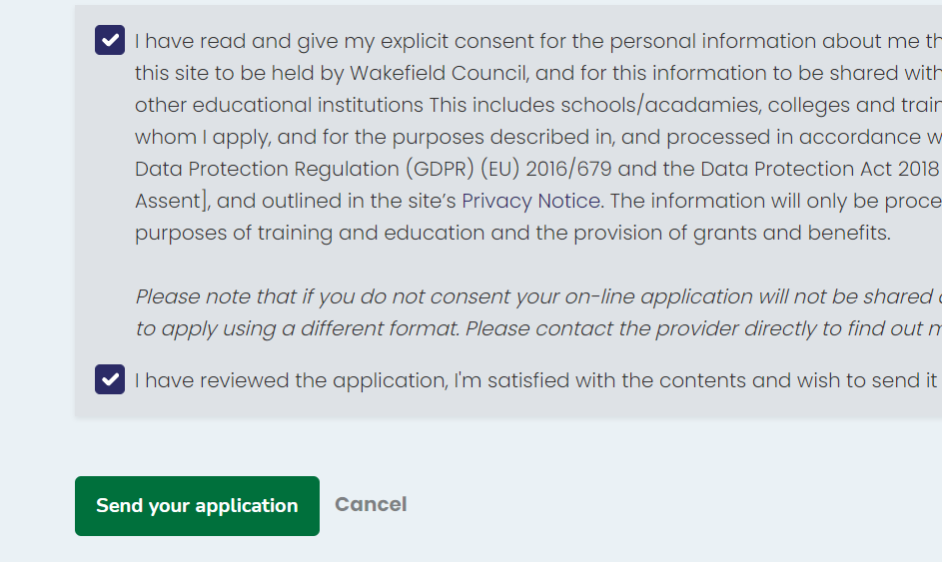
Last section – Send application
Tick the boxes to consent and press send your application

Slide 23
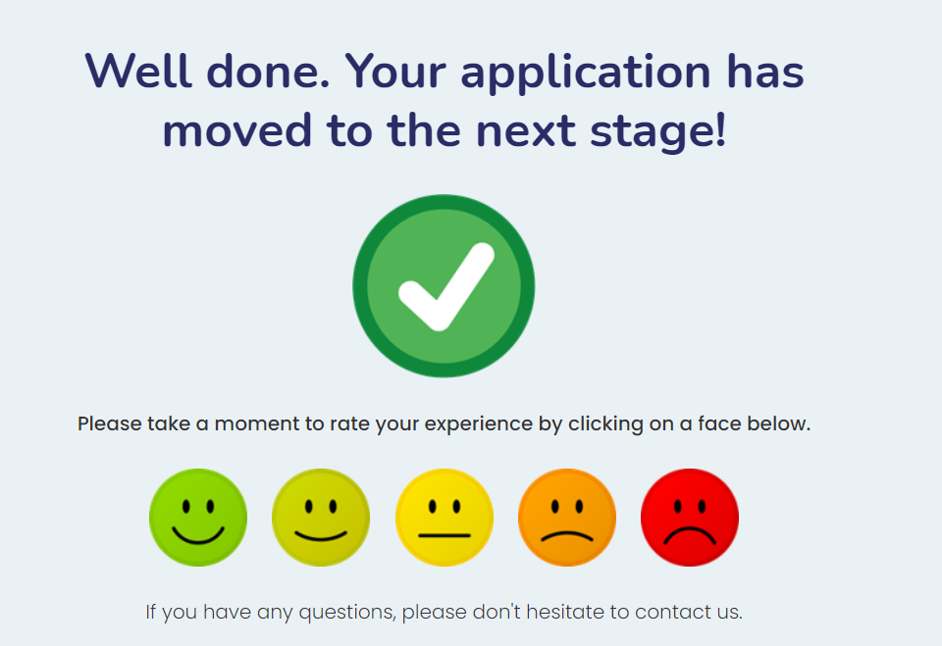
You will then get this message – your application is complete and you can now use this application to apply to other colleges

Slide 24
Congratulations on completing your application – If you need any support please drop me an email and let me know – we can arrange a meeting to get you applied
Email tdowey@minsthorpe.cc

